Slide 1
Trade and Tariffs
Steven Suranovic
George Washington University

Slide 2
Recent US Trade Policy Actions
Growing concern about globalization and international trade
Some, especially economists, claim that free trade with other countries is largely beneficial for the country
Others, especially labor unions and US firms that compete with imported goods, claim that the country is harmed because of international trade
Since China entered the World Trade Organization (WTO) in 2001, it has been singled out as contributing to harmful trade.

Slide 3
Recent US Trade Policy Actions
There is a general impression you’ll often hear about trade
Exports are good for the country
Imports are bad for the country
Long ago, in the time of Adam Smith, this was known as mercantilism
Adam Smith was opposed to this; advocated free trade
Today, the idea inspires concerns about trade deficits
A trade deficit means total imports > total exports
The large US and persistent trade deficit with China often is used to suggest that the US is being harmed

Slide 4
Recent US Trade Policy Actions
Recent US Trade actions against China are motivated in part by the large US trade deficit
One way to respond to these concerns is to implement a tariff (i.e., a tax on imported goods)
Recently US imposed ad valorem tariffs against China of up to 25%
China responded by placing tariffs up to 25% against the US

Slide 5
Effects of Trade and Tariffs
We will address several issues:
1) What are the economic effects when a country opens to trade and begins to export a product?
What happens to prices, domestic production and consumption, consumer and producer surplus and market welfare
2) What are the economic effects when a country opens to trade and begins to import a product?
3) What are the economic effects when an importing country implements a tariff?

Slide 6
Small vs Large Countries
A small country is defined as one whose trade with the rest of the world is too small to have an impact upon the prices in other countries
This is like a small firm assumption in perfect competition - in PC, firms are assumed to be too small to affect the market price. They therefore maximize profit subject to the prevailing market price.
A large country is defined as one whose trade policy actions do have an impact upon the prices in other countries (analyzed in an international trade course)

Slide 7
Effects of Exports
Suppose a small country with a perfectly competitive market is initially in autarky
Autarky means no trade with other countries (isolationist)
North Korea perhaps closest to a country near autarky
The autarky price and quantity is the supply-demand intersection.
Suppose the world price is higher than the country’s autarky price
Assume transportation costs are zero (simplifying assumption)

Slide 8
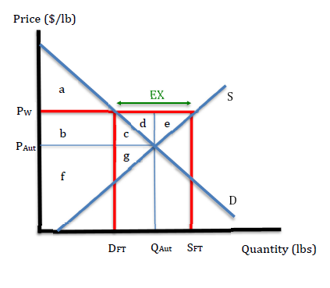
Effects of Opening to Trade: Exporter Case
Pw > PAut
Exporters will drive trade
Profit seeking firms will wish to sell at P_{W} rather than P_{Aut}
Extra supply abroad → less supply at home → domestic price rises to P_{W}
Demand falls to D_{FT}
Supply rises to S_{FT}
Exports = S_{FT} - D_{FT}

Slide 9
Effects of Opening to Trade: Exporter Case
Welfare Effects of trade
ΔCS = - (b + c)
ΔPS = + b + c + d + e
ΔMW = + d + e
Export firms benefit
Home Consumers lose
National welfare rises

Slide 10
Effects of Exports
Exports are indeed good for a country
MW increases (economic efficiency improves)
Exporting firms expand output and create more jobs
Note that greater output requires more inputs, such as workers
Workers move from other industries (or are new to the labor force)
But, exports are not good for everyone
Domestic Consumers of the exported goods are made worse-off because prices rise and the quantity consumed falls

Slide 11
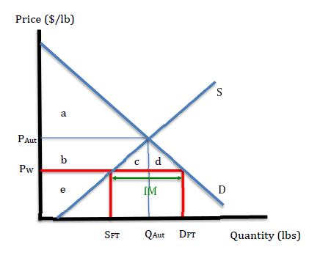
Effects of Opening to Trade: Importer Case
Pw < PAut
Consumers will drive trade
Utility seeking consumers will wish to buy at P_{W} rather than P_{Aut}
Extra demand abroad → less demand at home → domestic price falls to P_{W}
Demand rises to D_{FT}
Supply falls to S_{FT}
Imports = D_{FT} - S_{FT}

Slide 12
Effects of Opening to Trade: Importer Case
Welfare Effects of trade
ΔCS = + b + c + d
ΔPS = - b
ΔMW = + c + d
Home Consumers benefit
Import-competing firms lose
National welfare rises

Slide 13
Effects of Imports
Imports are also good for a country
MW increases (economic efficiency improves)
Consumers expand demand and pay less
But, imports are not good for everyone
Importing firms reduce output and layoff workers
Note that lower output requires fewer inputs, such as workers
Workers move to other industries (if whole economy is PC)
Imports from China said to have caused 2.4 million job losses over 12 years mostly in manufacturing …. Known as the “China Shock”

Slide 14
Josef Schumpeter (1883 – 1950)
Known for idea of “Creative Destruction”
In a dynamic economy sometimes conditions inspire greater supply and jobs are created (eg. exports)
Sometimes conditions inspire lower supply and jobs are lost (eg. imports)
Labor market “churning” is normal
See monthly labor separations and hires

Slide 15
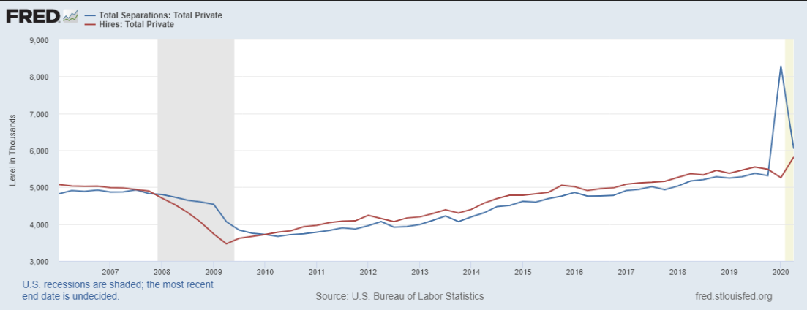
Monthly US Labor Separations and Hires 2006-2020
Graph shows the monthly “churning” in the US labor market
China trade estimated to cause as many as 20 thousand job losses per month
That’s 20K out of 4500K separations each month … not a very big shock!

Slide 16
Overall Effects of Trade
Mercantilist and popular view that exports are good and imports bad for a country, conflicts with standard results in perfectly competitive markets
The economics result instead is that
exports are good and
imports are good too
Again, based on market welfare or overall economic efficiency
Walmart Effect – lower income households benefit greatly from the lower prices caused by international trade

Slide 17
Real Income Gains from Trade relative to Autarky
Country | Aggregate | 10th income percentile | 90th income percentile
US | 8% | 69% | 4%
UK | 14% | 54% | 10%
Germany | 26% | 56% | 21%
Canada | 29% | 60% | 25%
Mexico | 24% | 65% | 21%
Lithuania | 67% | 87% | 63%
Hungary | 68% | 84% | 65%
Average | 32% | 63% | 28%
Fajgelbaum, Pablo D. and Amit K. Khandelwal (2016). Measuring the Unequal Gains from Trade. The Quarterly Journal of Economics, 2016: 1113-1180.

Slide 18
Effects of a Tariff
Suppose a small country with a perfectly competitive market is initially importing a product
Suppose the government implements a specific import tariff
A tariff is a tax on an imported good
It is collected by US customs when goods enter the country
It seems as if it is paid for by the exporting firms …

Slide 19
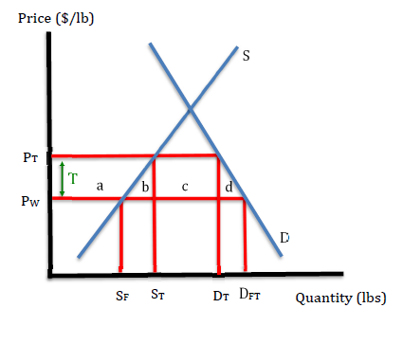
Effects of a Tariff: Small Country Case
Let the Tariff = T ($/lb)
The price rises by the full amount of the tariff, such that
P_{FT} + T = P_{IM}
Supply rises, S_{FT} to S_{T};
Demand falls, D_{FT} to D_{T}
Imports fall from D_{FT} - S_{FT} to D_{T} - S_{T}

Slide 20
Effects of a Tariff: Small Country Case
Welfare Effects of the tariff
ΔCS = - (a + b + c + d)
ΔPS = + a
ΔGR = + c
ΔMW = - b - d
Consumers lose
Import-competing producers benefit
Taxpayers benefit
National welfare falls

Slide 21
Effects of a Tariff
Tariffs are harmful for a country
MW decreases (economic efficiency worsens)
Consumers pay higher prices and consume less
Note that home consumers pay the tariff, not the foreign firms
But, tariffs are good for some
Import-competing firms increase output and hire workers
Tariffs reduce competition; increases home monopoly power
Tariff revenue is collected and used for public goods
Taxpayers/citizens benefit

Slide 22
Effects of a Tariff
Benefits from Tariffs are visible
Hundreds of import-competing firms knowingly benefit from tariffs
Thousands of workers in same industries know their jobs are secured
The government notices increased tariff revenues
Losses from tariffs are invisible
Walmart Effect – toasters, microwaves, furniture, clothing, etc. all cost just a little bit more for hundreds of millions of consumers because of trade. But not enough for any one person to notice.

Slide 23
Effects of a Tariff
Recall the Trojan Story earlier in the class
The effects of the tariff are similar to the Trojan program. It transfers money from lots of consumers, who will never notice, to the pockets of domestic firms who are granted more monopoly power in their industry.
A firm cannot legally hire someone to write a computer program to transfer a small amount of money from every depositor, even though the depositor would never notice it.
A firm can legally hire a lobbying firm to convince legislators to raise a tariff on imports that are competing with one’s domestically produced product.

Slide 24
Effective Lobbying
To make lobbying effective it is important to convince legislators and the people that the tariff is good for the country (even if this is factually false)
Emphasize business success with tariffs
Emphasize job gains
Emphasize unfair practices of foreign firms and governments
Very low foreign wages, poor working conditions, export subsidies, etc.
Minimize costs to consumers (if it is ever brought up) See next slide.
A majority of people can then be convinced that the action is “good for the country” despite economic arguments to the contrary.

Slide 25
Effective Lobbying

